Slide 1
MOTION TRACKING IN REAL TIME VIDEO

Slide 2
Outline
Introduction to Motion Tracking
Techniques
Optical Flow and its algorithms
Comparative results
Conclusion and Future Work
References

Slide 3
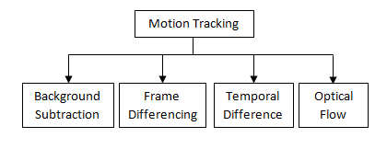
Introduction to Motion Tracking
Motion tracking - involves tracking the movement of any object within the scope of the area under surveillance.
Surveillance - involves constant monitoring of activities and events within the coverage area.
In motion tracking, camera background can be either static or dynamic.

Slide 4
Motion Tracking Techniques
Background Subtraction:
  Background frame fixed initially.
  Difference between current and background frame computed gives the displacement of moving object.
Frame Differencing:
  Compares two successive frames to compute the motion of objects

Slide 5
Motion Tracking Techniques
Temporal Differencing:
  Compares two successive frames to compute the motion of objects.
  But comparison done at pixel level.
  Poor results while tracking objects with very slow/fast movements
Optical Flow:
  visual interpretation of the relative motion between the observer and the object that is observed.
  makes a pixel to pixel correspondence of objects between two defined time frames.

Slide 6
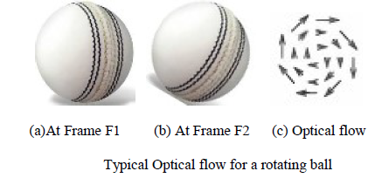
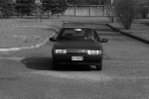
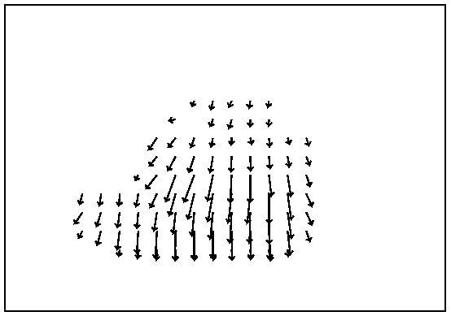
Optical Flow Examples

Slide 7
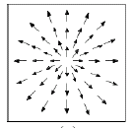
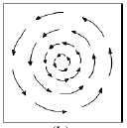
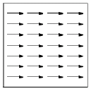
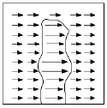
Examples of motion fields
Forward motion
Rotation
Horizontal translation
Closer objects appear to move faster!!

Slide 8
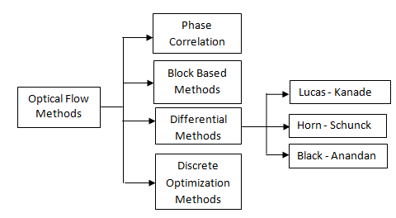
Taxonomy of optical flow methods

Slide 9
Lucas Kanade Algorithm
Assumption: intensity change between nearby points is uniform.
Localized method for finding optical flow.
A weighted window (matrix) representing the neighborhood points is selected.
The method of least squares is employed to find the optical flow for the given input image.
Size of the sliding window should not be altered during the course of determining the optical flow.
cv.calcOpticalFlowPyrLK()

Slide 10

Horn-Schunck Algorithm
Global method for finding the optical flow.
A global energy function is initially computed and minimized using calculus of variations.
where Ix, Iy and Iz denote the image intensity derivative values along the x, y and z directions respectively.
Intensity of flow vector is high.
cv.calcOpticalFlowFarneback

Slide 11
Experimental setup
Software used: Python, OpenCV
OS: Windows 10

Slide 12
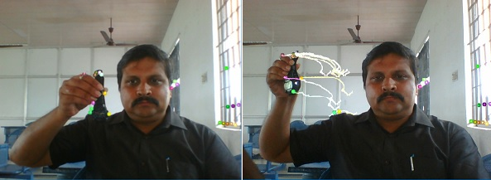
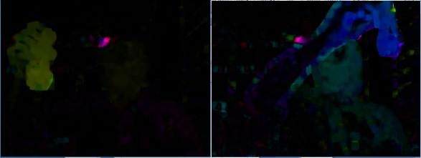
Object detection and tracking – Output
Lucas – Kanade output
Horn - Schunck output

Slide 13
Object detection and tracking – Comparison of algorithms
S.No | Aspect of Comparison | Lucas-Kanade Algorithm | Horn-Schunck Algorithm
1. | Coverage | Local space | Global space
2. | Optical flow method | Differential | Differential
3. | Methodology | A small sliding window is moved across to determine the optical flow directions. | Global energy function is computed and this is minimized using differentiation
4. | Sensitivity to noise | This method is less sensitive to noise as this is a local method. | More sensitive to noise than Lucas - Kanade algorithm
5. | Time complexity | Linear | Quadratic
6. | Application scope | This method is applicable for tracking objects with moderate operating speed. | Applicable for tracking objects with high speed movement
7. | Density of optical flow vectors generated | Less when compared to Horn-Schunck method. | More when compared to Lucas-Kanade method
8. | Addressing aperture problem | No | Yes
9. | Dependencies | The performance of this system is highly dependent on the size of the sliding or moving window that is selected. | The video should be cleared or smoothened by removing noisy data before applying this algorithm
10. | Advantages | Sliding window size is small and hence takes less computational time. Less sensitive to noise. | More sensitive to noise. Dense optical flow vectors generated as output. Highly effective even in uniform surfaces
11. | Limitations | This method is less effective when applied across uniform surfaces. | Higher time complexity and sensitivity to noise.

Slide 14
Reference Link
Open CV - Optical Flow Sample Code.

Slide 15
Thank you

